Slide 1




Week-6 (Discussion)
2nd September, 2024
Introduction to Machine Learning
Prof. Balaraman Ravindran
Professor and Head of the Department
Department of Data Science and Artificial Intelligence
IIT Madras
Ayan Paul
PMRF Research Scholar
IIT Kharagpur

Slide 2
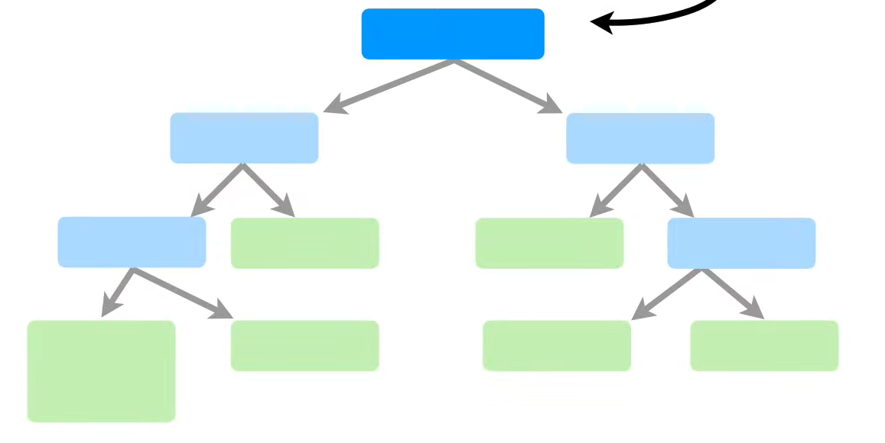
Decision Tree
A decision tree is a type of supervised learning algorithm that is commonly used in machine learning to model and predict outcomes based on input data.
They can be used to solve both regression and classification problems.
It is a tree-like structure where each internal node tests on attribute, each branch corresponds to attribute value and each leaf node represents the final decision or prediction.
Root Node or Root
Internal Nodes or Branches
Leaf Nodes or Leaves

Slide 3
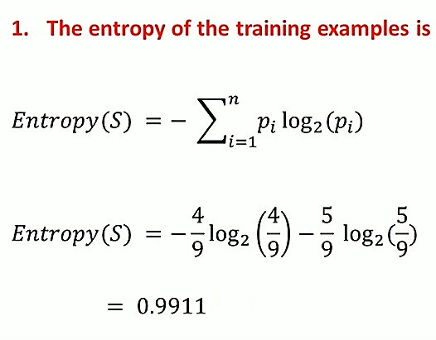
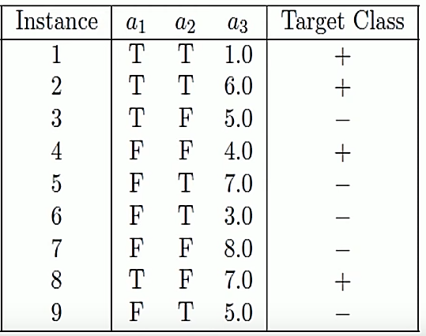
Entropy, Information Gain and Gini Index
Example for Computation
Entropy in a decision tree is a measure of uncertainty or impurity in a dataset. It quantifies the amount of disorder or randomness in the data and is used to determine how a decision tree splits the data at each node.

Slide 4
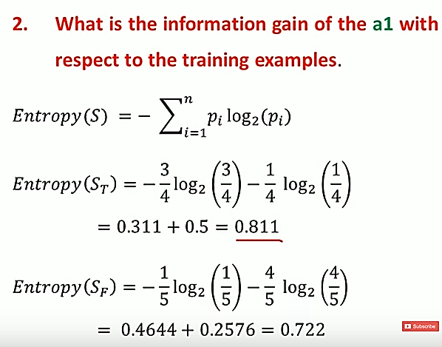
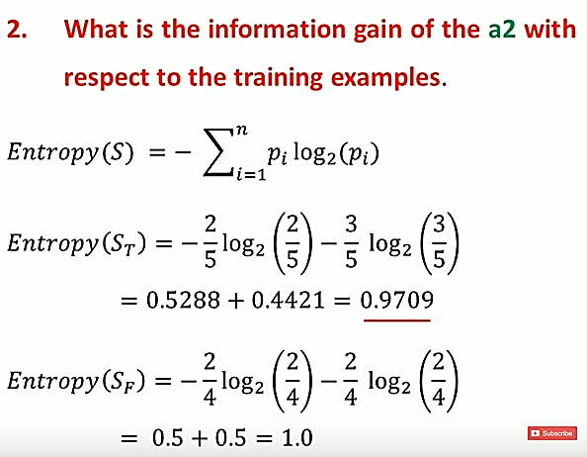
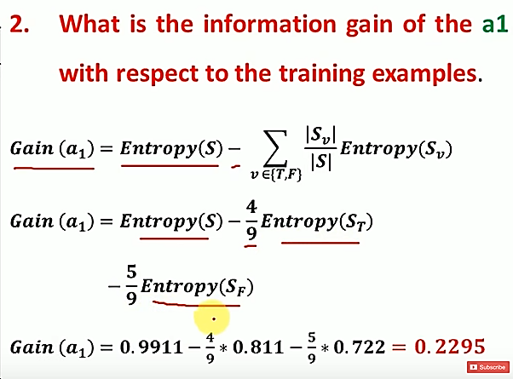
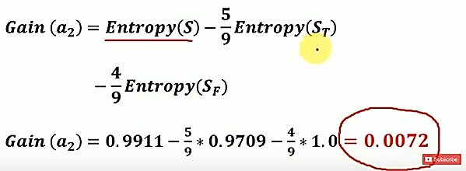
Information gain in a decision tree is a measure used to determine which feature to split the data on at each step of building the tree. It quantifies the reduction in entropy or impurity that a particular split will achieve. Essentially, it helps in selecting the feature that will best separate the data into distinct classes.

Slide 5
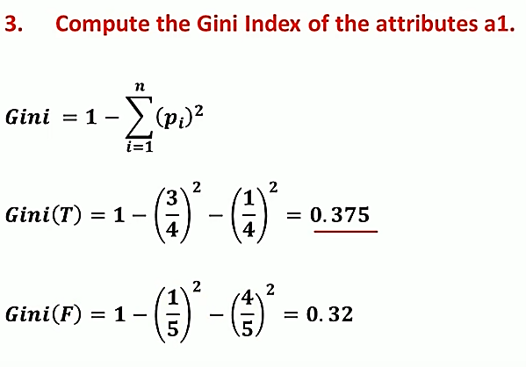
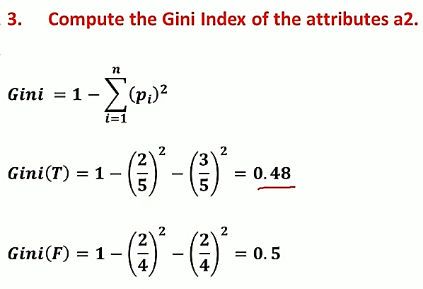
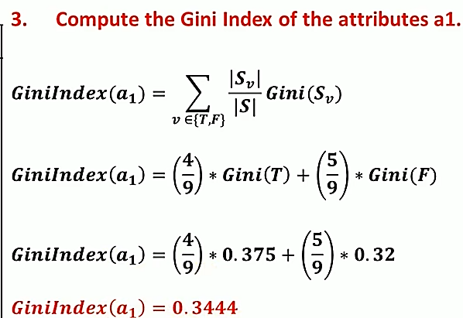
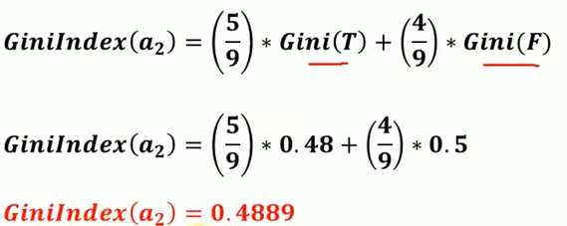
The Gini index, also known as Gini impurity, is another measure of impurity or disorder used in decision trees, similar to entropy. It quantifies the probability of a randomly chosen element being incorrectly classified if it was randomly labeled according to the distribution of classes in the dataset.

Slide 6
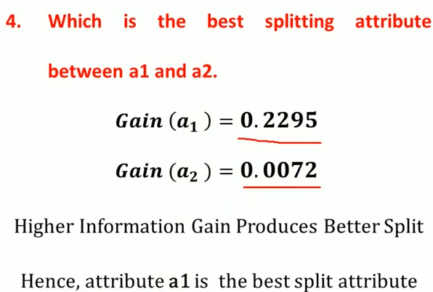
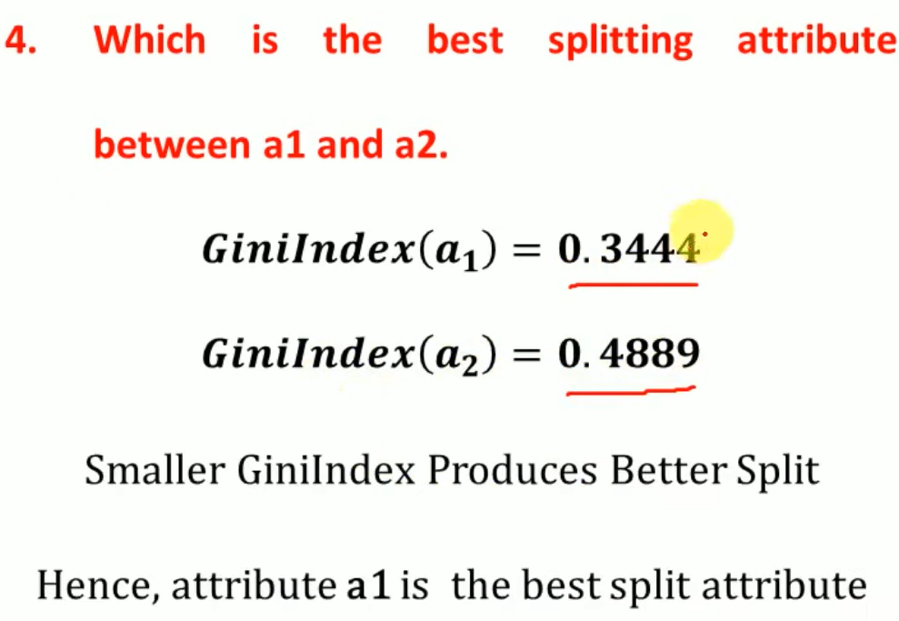

Slide 7
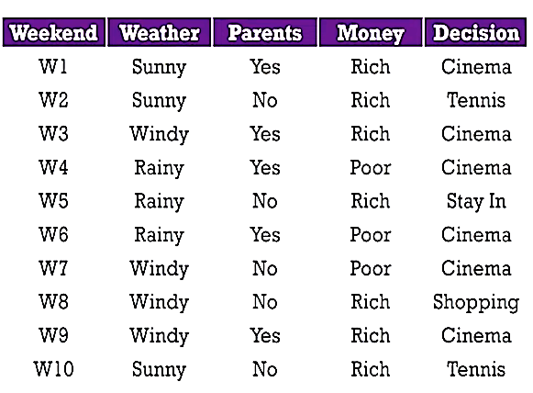
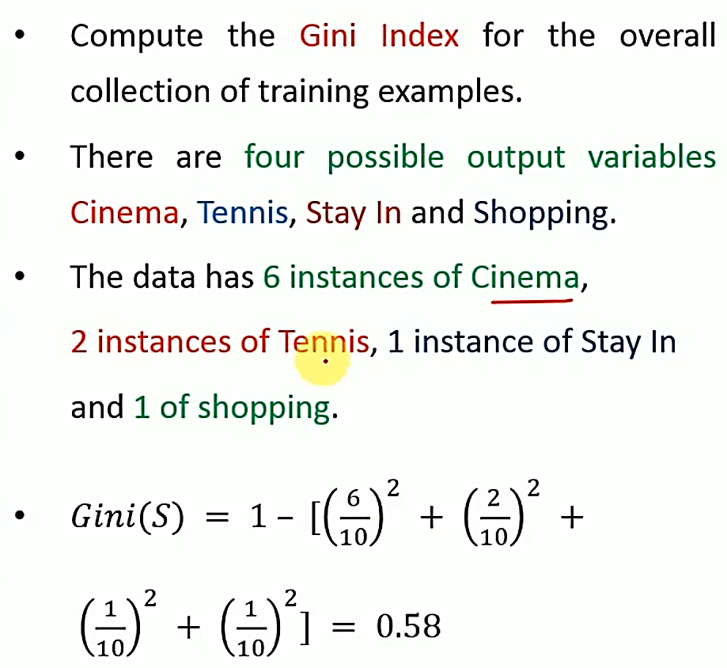
Example for Tree Creation

Slide 8
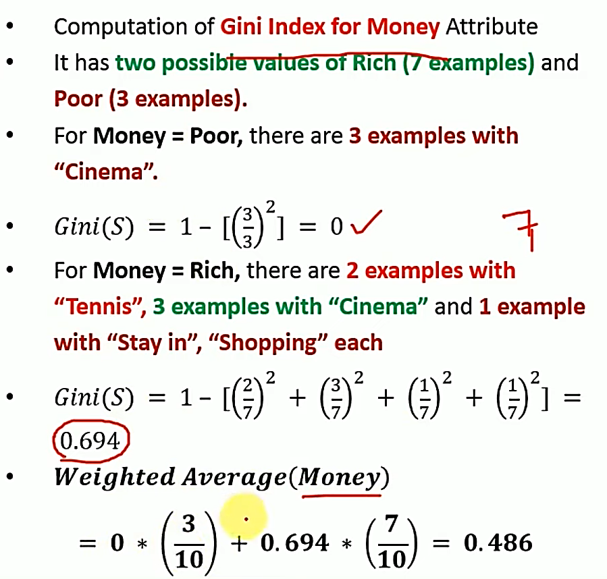
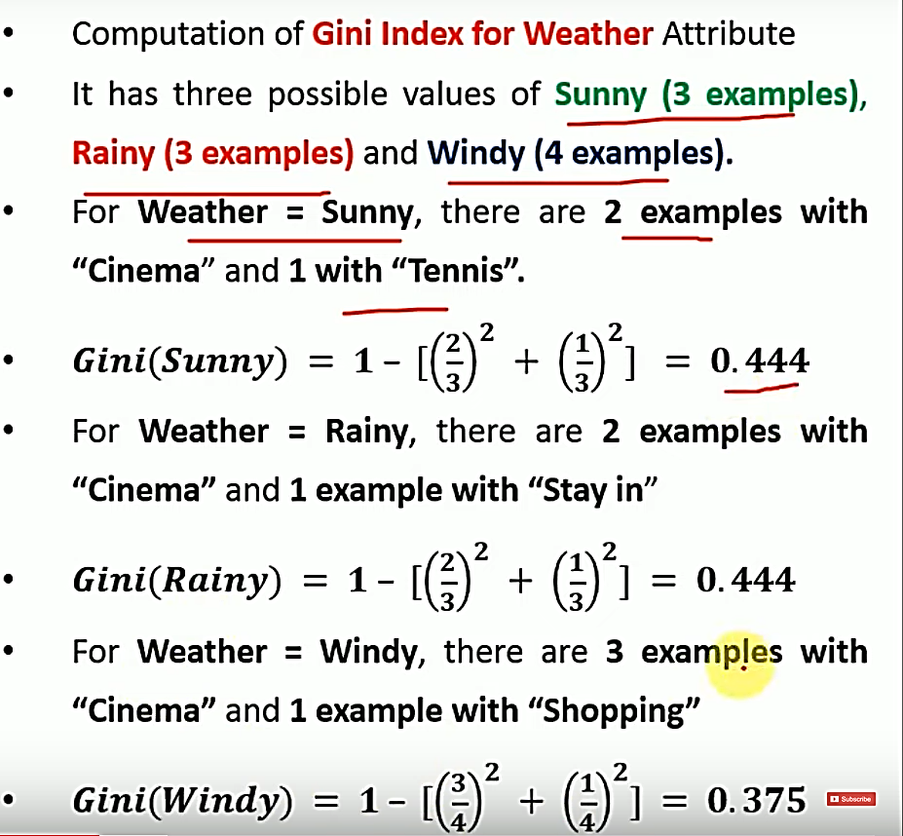
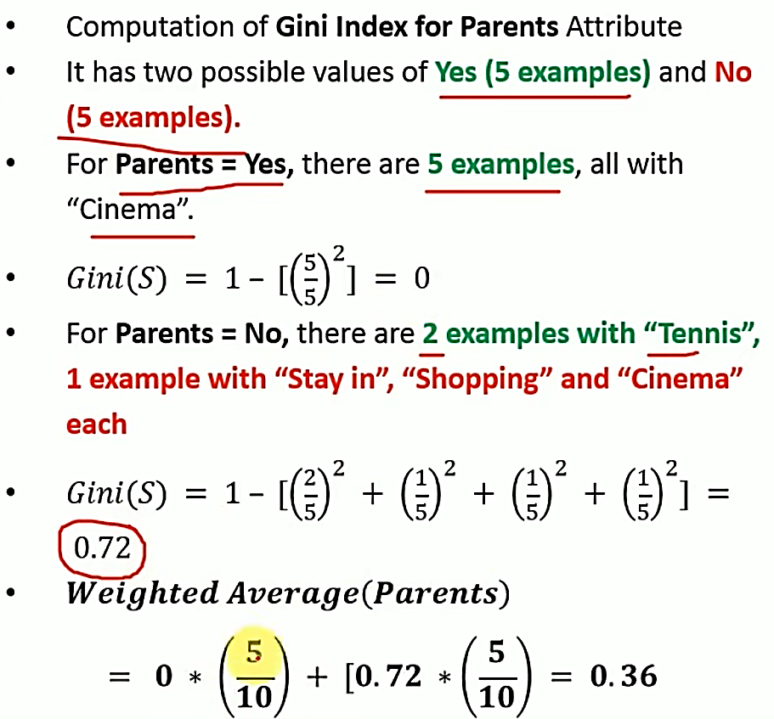
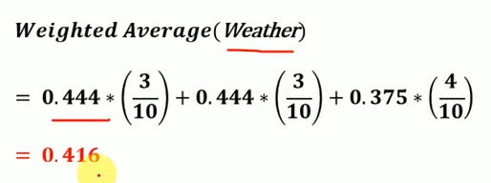
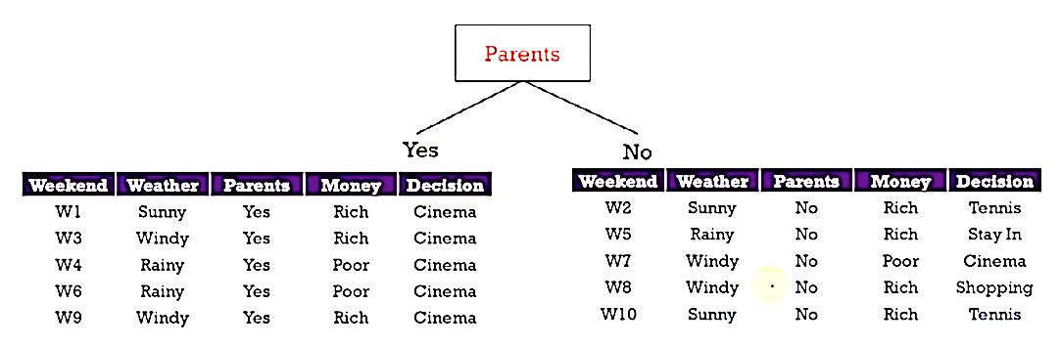
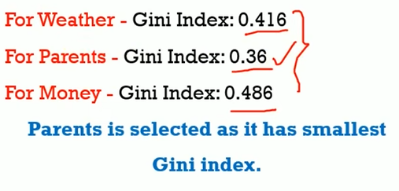

Slide 9
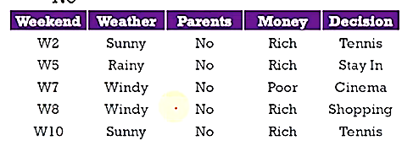
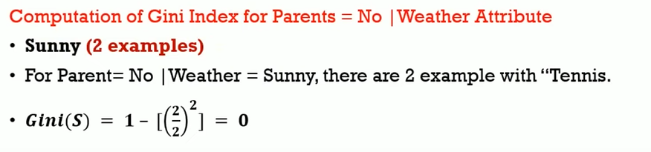
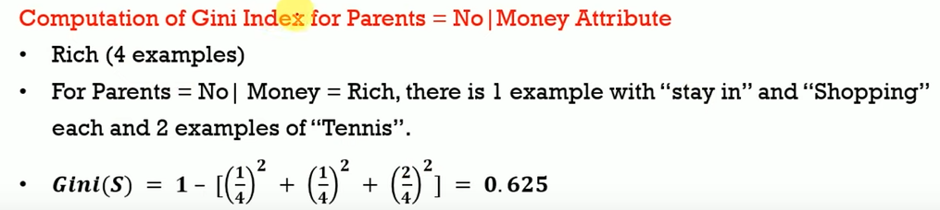
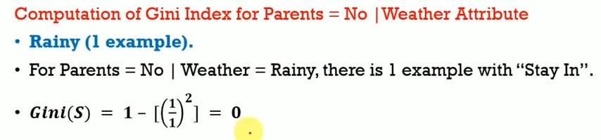
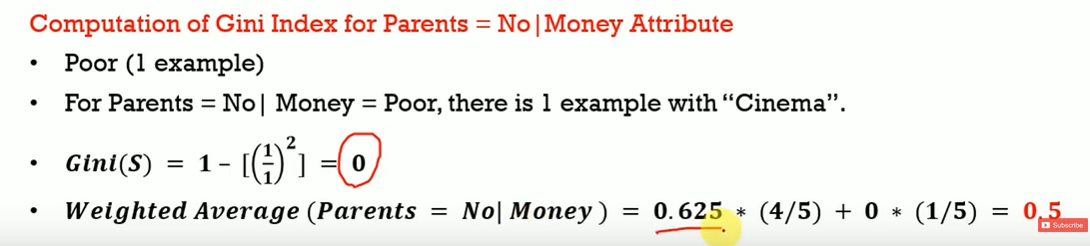
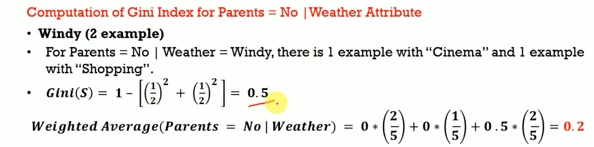
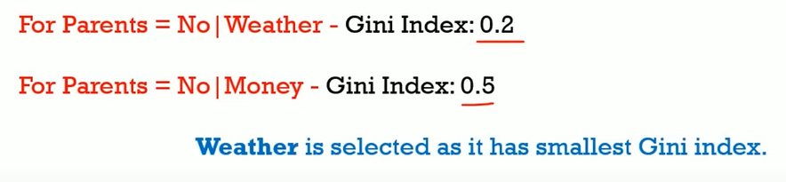

Slide 10
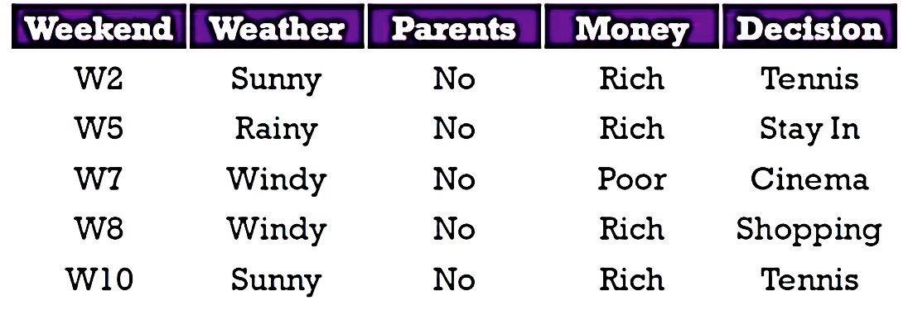
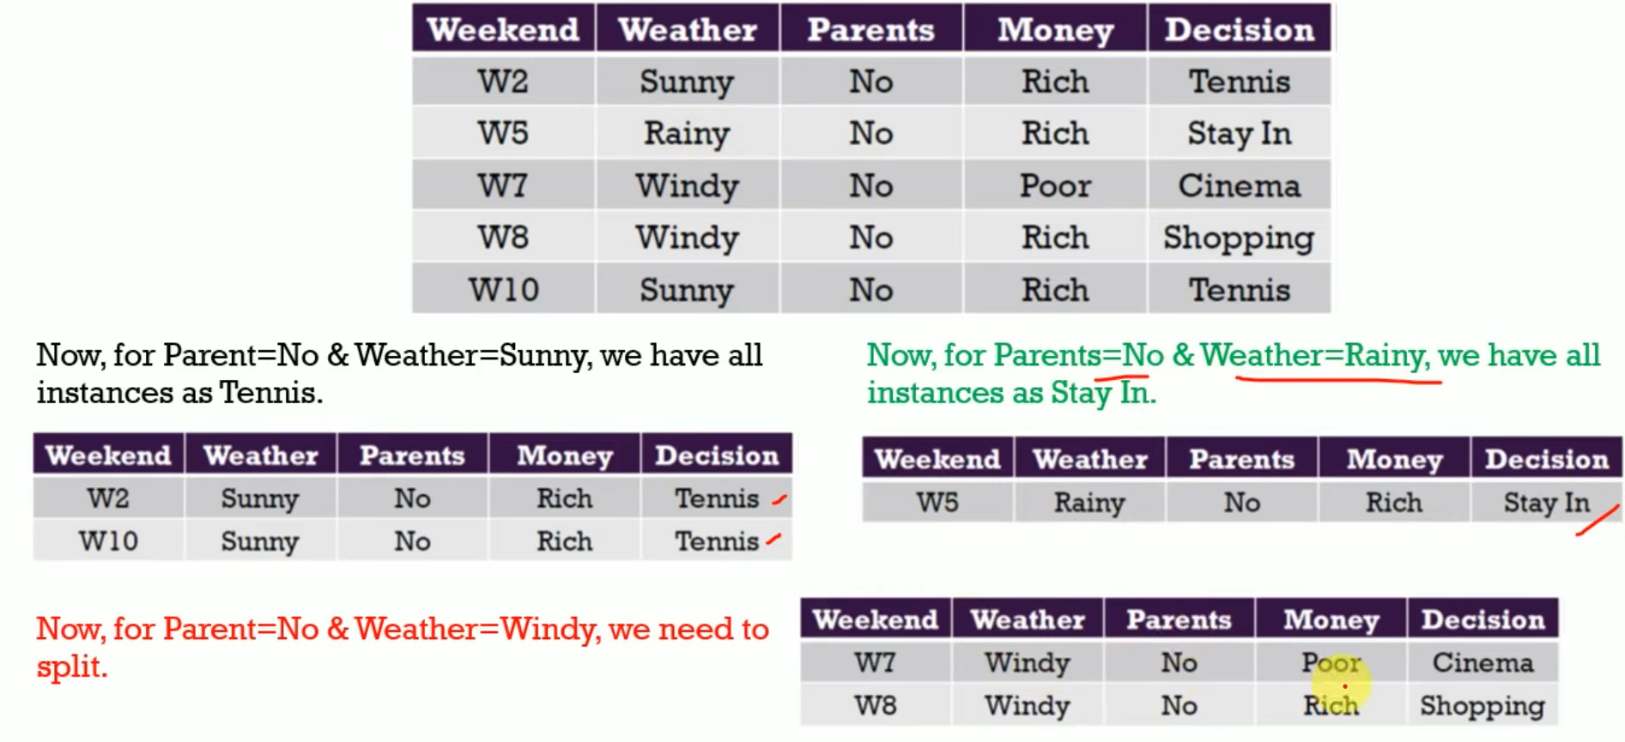
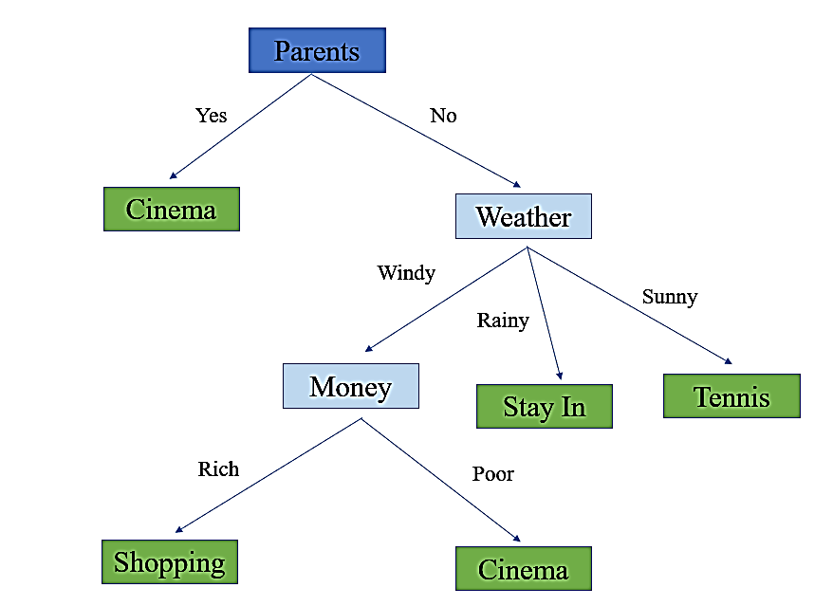

Slide 11
Topics on which Week 6 Assignment Questions are based
1. Decision Trees

Slide 12
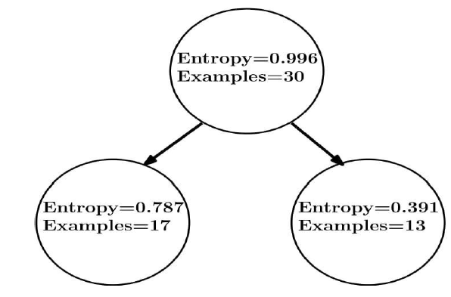
QUESTION 1
1. The value of information gain in the following decision tree is:
0.380
0.620
0.190
0.477
SOLUTION 1
Information Gain = 0.996 - ( (17/30) × 0.787 + (13/30) × 0.391 ) = 0.380
CORRECT ANSWER 1
a

Slide 13
QUESTION 2
Which of the following properties are characteristic of decision trees?
a) High bias
b) High variance
Unbounded parameter set
None of the above
SOLUTION 2
Decision trees are generally unstable considering that a small change in the data set can result in a very different set of splits. This is mainly due to the hierarchical nature of decision trees, since a change in split points in the initial stages will affect all the subsequent splits.
Decision trees do not make any assumptions about the distribution of the data. They are non-parametric methods where the number of parameters depends solely on the data set on which training is carried out.
CORRECT ANSWER 2
b), c)

Slide 14

QUESTION 3
Entropy for a 50-50 split between two classes is:
a) 0
b) 0.5
c) 1
d) None of the above
SOLUTION 3
CORRECT ANSWER 3
c)

Slide 15
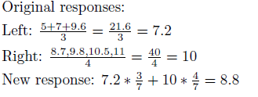
QUESTION 4
Having built a decision tree, we are using reduced error pruning to reduce the size of the tree. We select a node to collapse. For this particular node, on the left branch, there are 3 training data points with the following feature values: 5, 7, 9.6 and for the right branch, there are four training data points with the following feature values: 8.7, 9.8, 10.5, 11. What were the original responses for data points along the two branches (left & right respectively) and what is the new response after collapsing the node?
(a) 10.8, 13.33, 14.48
(b) 10.8, 13.33, 12.06
(c) 7.2, 10, 8.8
(d) 7.2, 10, 8.6
SOLUTION 4
CORRECT ANSWER 4
c)

Slide 16
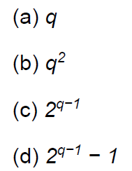
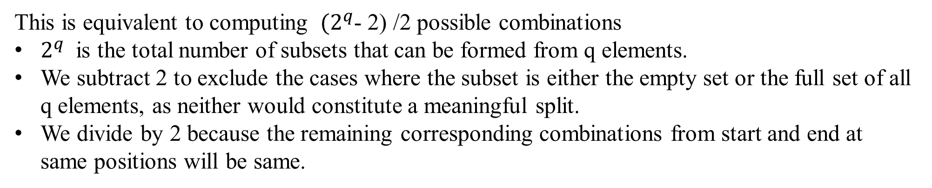
QUESTION 5
Consider a dataset with only one attribute(categorical). Suppose there are q unordered values in this attribute. How many possible combinations are needed to find the best split-point for building the decision tree classifier?
(Note: The decision tree only makes binary splits).
SOLUTION 5
CORRECT ANSWER 5
d)

Slide 17
QUESTION 6
Consider the following statements:
Statement 1: Decision Trees are linear non-parametric models.
Statement 2: A decision tree may be used to explain the complex function learned by a neural network.
Both the statements are True.
Statement 1 is True, but Statement 2 is False.
Statement 1 is False, but Statement 2 is True.
Both the statements are False.
SOLUTION 6
Decision trees are non-linear models. They make predictions by splitting the data based on features at each decision node, and these splits can be based on non-linear conditions. For instance, a decision node might split the data based on whether a specific feature is greater than, less than, or equal to a certain threshold.
A decision tree can be used as an interpretability tool to approximate the complex function learned by a neural network. By recursively partitioning the input space, a decision tree can provide insights into the regions where the neural network makes specific predictions.
CORRECT ANSWER 6
c)

Slide 18
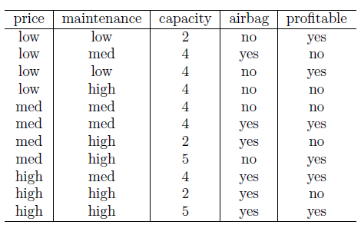
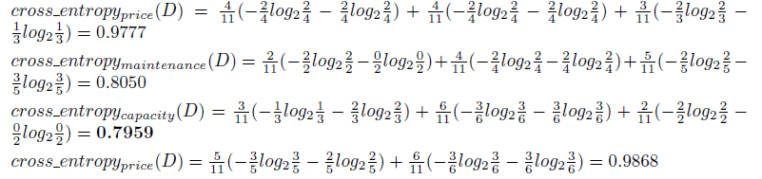
QUESTION 7
Consider the following data set:
Considering ‘profitable’ as the binary values attribute we are trying to predict, which of the attributes would you select as the root in a decision tree with multi-way splits using the cross-entropy impurity measure?
a) price
b) maintenance
c) capacity
d) airbag
SOLUTION 7
CORRECT ANSWER 7
c)

Slide 19
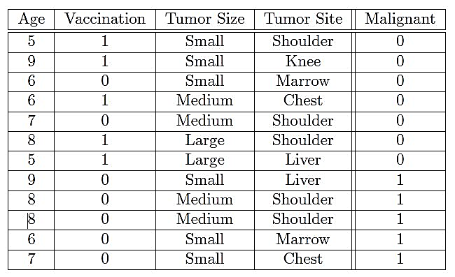
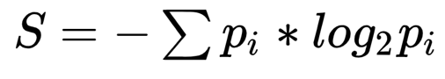

QUESTION 8
What is the initial entropy of Malignant?
0.543
0.9798
0.8732
1
SOLUTION 8
CORRECT ANSWER 8
b)

Slide 20
QUESTION 9
Which of the following is/are major advantages of decision trees over other supervised learning techniques? (Pick one)
Theoretical guarantees of performance
Higher performance
Interpretability of classifier
More powerful in its ability to represent complex functions
SOLUTION 9
Decision trees are highly interpretable, which is one of their major advantages. The model’s decisions can be easily visualized and understood, as it clearly lays out the decision-making process from root to leaf.
CORRECT ANSWER 9
c)

Slide 21
QUESTION 10
Which of the following is true for a decision tree?
Decision tree is an example of linear classifier.
The entropy of a node typically decreases as we go down a decision tree.
The entropy of a set increases with its purity
An attribute with lower information gain is preferred to an attribute with higher information gain.
SOLUTION 10
Decision tree is an example of a linear classifier. False. Decision trees are non-linear classifiers because they can capture complex patterns in the data by partitioning the feature space into regions with different class labels. Linear classifiers, like logistic regression or SVM with a linear kernel, separate data with a straight line (or hyperplane in higher dimensions).
The entropy of a node typically decreases as we go down a decision tree. True. As we move down a decision tree, the data is split into more homogeneous subsets, meaning the uncertainty or entropy usually decreases. This is because each split aims to group similar instances together, reducing the disorder.
The entropy of a set increases with its purity. False. The entropy of a set actually decreases with its purity. When a set is pure (all instances belong to the same class), the entropy is 0, which represents no uncertainty.
An attribute with lower information gain is preferred to an attribute with higher information gain. False. In decision trees, attributes with higher information gain are preferred because they more effectively reduce uncertainty and create purer nodes.
CORRECT ANSWER 10
b)

